Slide 1

Handwritten Digit Recognition with SVM and Image Preprocessing Techniques
SRM INSTITUTE OF SCIENCE AND TECHNOLOGY
SCHOOL OF COMPUTING
DEPARTMENT OF COMPUTING TECHNOLOGIES
21CSC305P-Machine Learning
Mini Project
Review III
Student 1: RA2311003010677
Ushnish Ghosal
Student 2 : RA2311003010679
Aayush Mishra
Student 3:RA2311003010685
Divyansh Aggarwal
Student 4 :RA2311003010691
Gautam Kumar

Slide 2
Problem Overview
Problem Recap: Recognizing handwritten digits from varied sources is challenging due to noise, distortions, and diverse handwriting styles. While standard models work on clean datasets like MNIST, their accuracy drops on complex, real-world images.
Project Evolution:
Review 1: Proposed using SVM for its robustness in high-dimensional spaces.
Review 2: Implemented an efficient PCA+SVM pipeline to reduce dimensionality (from 784 to 50) and training time, achieving 97.86% accuracy.
Review 3 (Current): To push for superior accuracy, we replaced the linear PCA-based feature extraction with a Convolutional Neural Network (CNN), creating a hybrid CNN-PCA-SVM model.
Motivation: The goal is to compare our efficient PCA+SVM model against a deep learning feature extraction approach to determine the performance ceiling for this task.

Slide 3
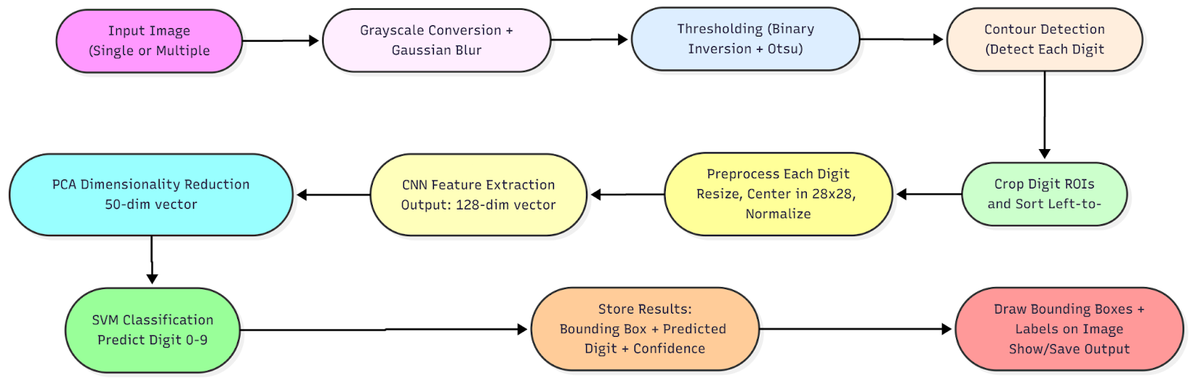
System Architecture / Workflow
1. Input Image
A single or multi-digit grayscale image (MNIST-style 28x28 for single digits, larger for multi-digit images).

Slide 4
System Architecture / Workflow
2. Preprocessing (for multi-digit images)
Convert to grayscale (if not already).
Apply Gaussian blur to reduce noise.
Thresholding (Binary Inversion + Otsu) to separate digits from background.
Detect contours → identify bounding boxes for individual digits.
Sort bounding boxes left-to-right for correct reading order.
3. Digit ROI Preprocessing (for CNN input)
Crop each digit region.
Resize while preserving aspect ratio (to fit 20x20 inside 28x28).
Center digit in 28x28 black frame.
Apply center-of-mass shift for alignment.
Normalize pixel values (0–1) and reshape to (1,28,28,1) for CNN.
4. Feature Extraction with CNN
Feed preprocessed digit into a trained CNN:
  2 × Conv2D layers with ReLU activations
  2 × MaxPooling2D layers
  Flatten → Dense layer with 128 units
Output: 128-dimensional feature vector representing abstract digit features.

Slide 5
System Architecture / Workflow
5. Dimensionality Reduction with PCA
Apply PCA on the 128-dim vector to reduce to 50 principal components.
Benefits: Keeps the most important features and speeds up classification.
6. Classification with SVM
Feed the 50-dim PCA vector into a trained SVM classifier (RBF kernel, tuned C & gamma).
SVM predicts the digit class (0–9).
7. Postprocessing and Output
Store results for each detected digit:
  Bounding box coordinates
  Predicted digit
  Confidence score
Draw bounding boxes and predictions on the image.
Show or save annotated image.
8. Final Output
Predicted digit(s) with confidence score.
Annotated image visualization showing detected digits.

Slide 6
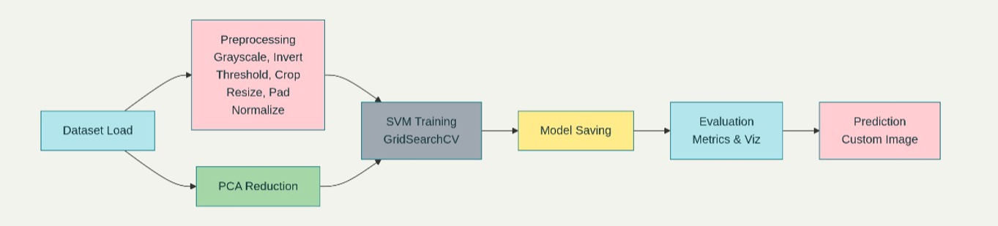
System Architecture / Workflow
This model (your second image) represents a more traditional or "classical" machine learning workflow. It does not use a neural network.
Feature Extractor: It relies on preprocessing and PCA directly on the raw pixel data.
  The Preprocessing step (thresholding, cropping, etc.) cleans the image.
  The PCA Reduction step is then applied to the (likely flattened) image pixels. Its job is to find the "principal components" or main patterns in the pixel data itself.
Output of PCA: The output is a set of feature vectors based on pixel variance, not on learned hierarchical patterns (like the CNN does).
Final Step:
SVM Training: The SVM is trained directly on these PCA-generated features. The GridSearchCV block indicates it's also testing many different SVM settings to find the best ones.

Slide 7
Algorithm / Model Summary
Component 1: Convolutional Neural Network (CNN)
Role: Acts as a powerful, non-linear feature extractor.
Core Idea: The CNN is trained on the raw 28x28 pixel images. Its internal layers learn to identify complex patterns, and its final dense layer outputs a high-level 128-dimensional feature representation.
Component 2: Principal Component Analysis (PCA)
Role: Acts as an efficient dimensionality reducer.
Core Idea: It takes the 128-dim vector from the CNN and reduces it to 50 dimensions. This makes the SVM training process much faster and more memory-efficient by retaining only the components with the highest variance.
Component 3: Support Vector Machine (SVM)
Role: Acts as the final classifier.
Core Idea: It takes the compact 50-dim vector from PCA and performs the classification. Because these 50 features are derived from the CNN's deep understanding (not raw pixels), they are highly discriminative, allowing the SVM to achieve near-perfect separation.
Justification: This 3-stage pipeline (CNN -> PCA -> SVM) gets the best of all worlds:
deep learning for feature quality (CNN), statistical reduction for efficiency (PCA), and robust classification for the final decision (SVM).

Slide 8
Implementation Highlights
Tools & Libraries:
TensorFlow / Keras: Used for loading the MNIST dataset and for building and training the CNN feature extractor.
Scikit-learn: Used for implementing the SVM classifier (SVC), Principal Component Analysis (PCA), and calculating all evaluation metrics.
Joblib: Used for saving (serializing) the trained pipeline.
NumPy: For numerical operations and data reshaping.
Dataset:
Name: MNIST (Modified National Institute of Standards and Technology).
Training Size: 60,000 images.
Testing Size: 10,000 images.
Format: 28x28 grayscale images.

Slide 9
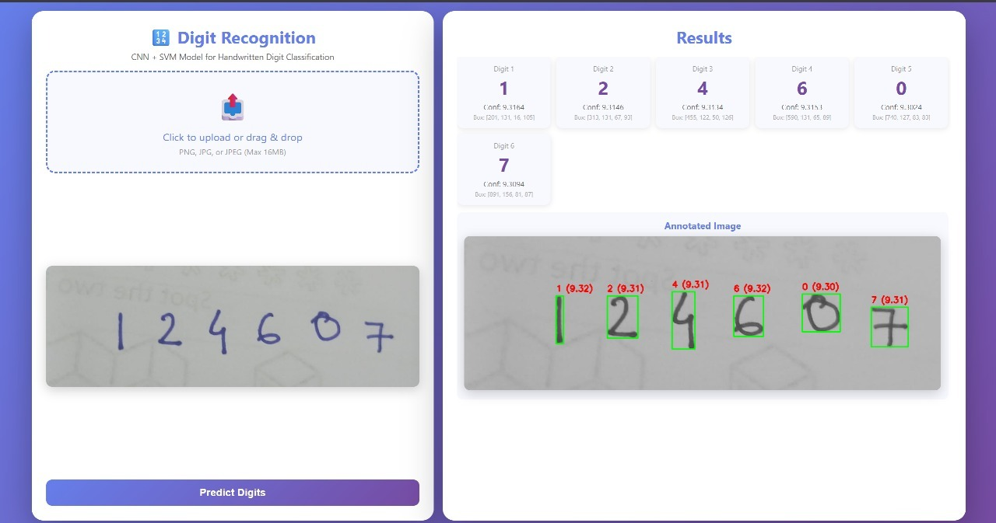
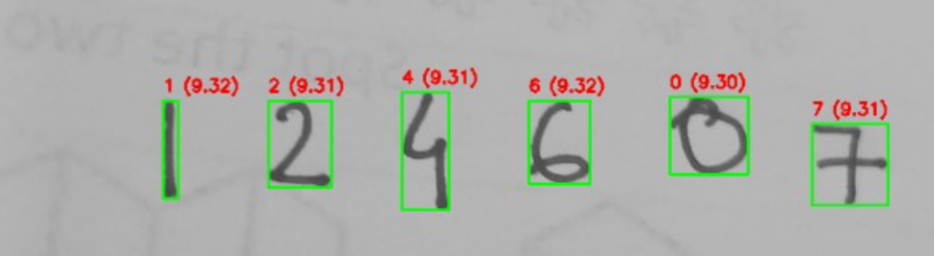
Demonstration

Slide 10
Comparative Analysis
Metric | CNN-PCA-SVM (New Model) | PCA-SVM (Review 2 Model) | Key Takeaway
Test Accuracy | 99.25% | 97.86% | The new model is ~1.4% more accurate.
Misclassified Samples | 75 / 10,000 | 214 / 10,000 | The new model makes 2.85x fewer errors.
Macro Avg F1-Score | 0.9924 | 0.978 | Better balance of precision and recall.
Macro Avg AUC | 0.99972 | 0.99970 | Both models excel at ranking predictions.

Slide 11
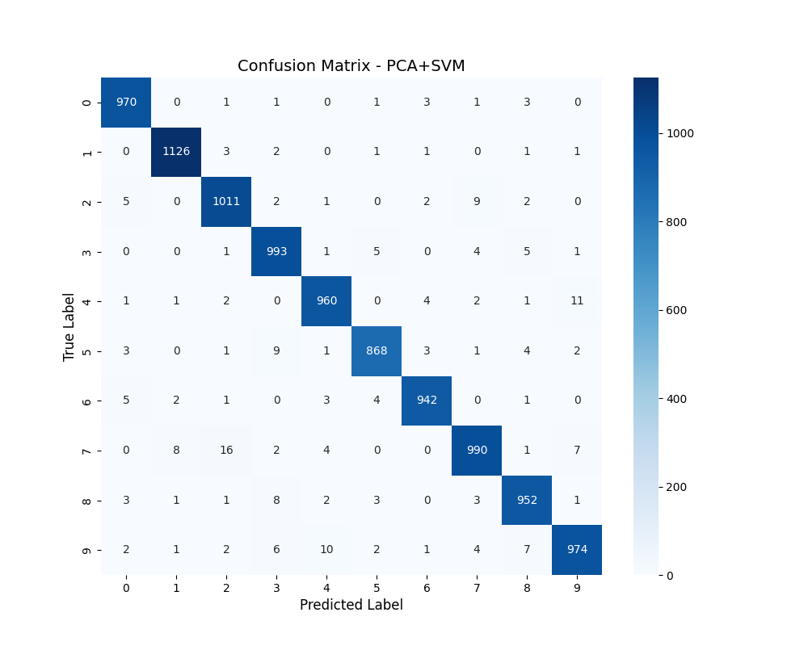

Result Interpretation
Key Insight: Feature Quality > Feature Quantity.
Our Review 2 model (PCA+SVM) applied PCA to 784 raw pixels to get 50 features, achieving 97.86% accuracy.
Our Review 3 model (CNN+PCA+SVM) also uses 50 final features, but it derives them from a 128-dim CNN-generated vector. This resulted in 99.25% accuracy.
This is an "apples-to-apples" comparison in terms of final feature dimensions. The ~1.4% accuracy jump proves that the quality of the features learned by the CNN is vastly superior to the linear features captured by PCA on raw pixels.
ONLY SVM CNN + SVM

Slide 12
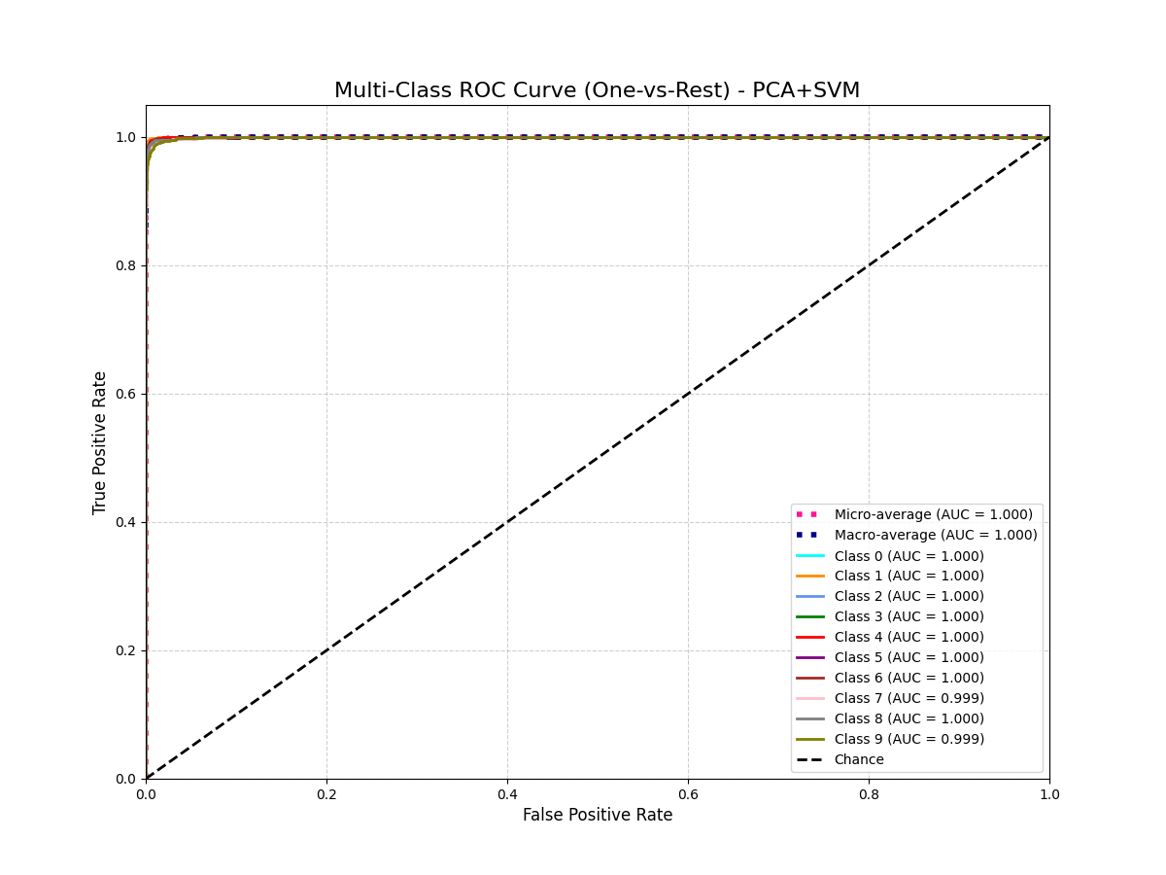
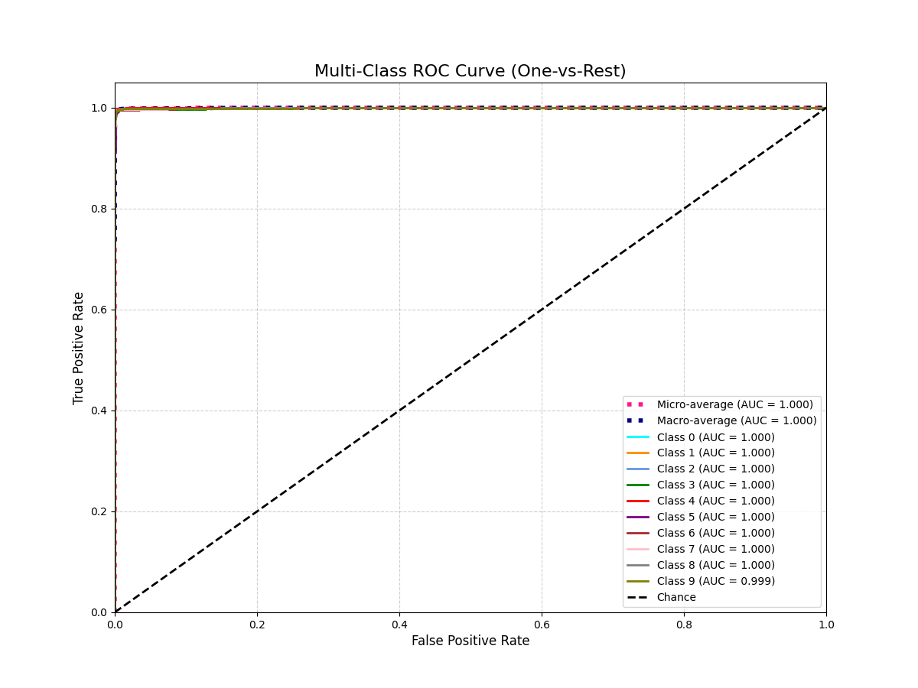
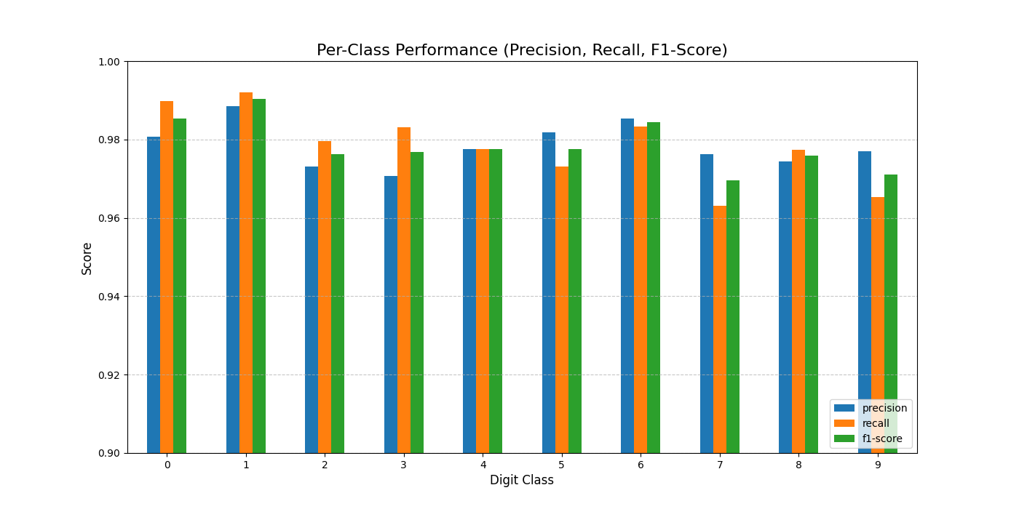
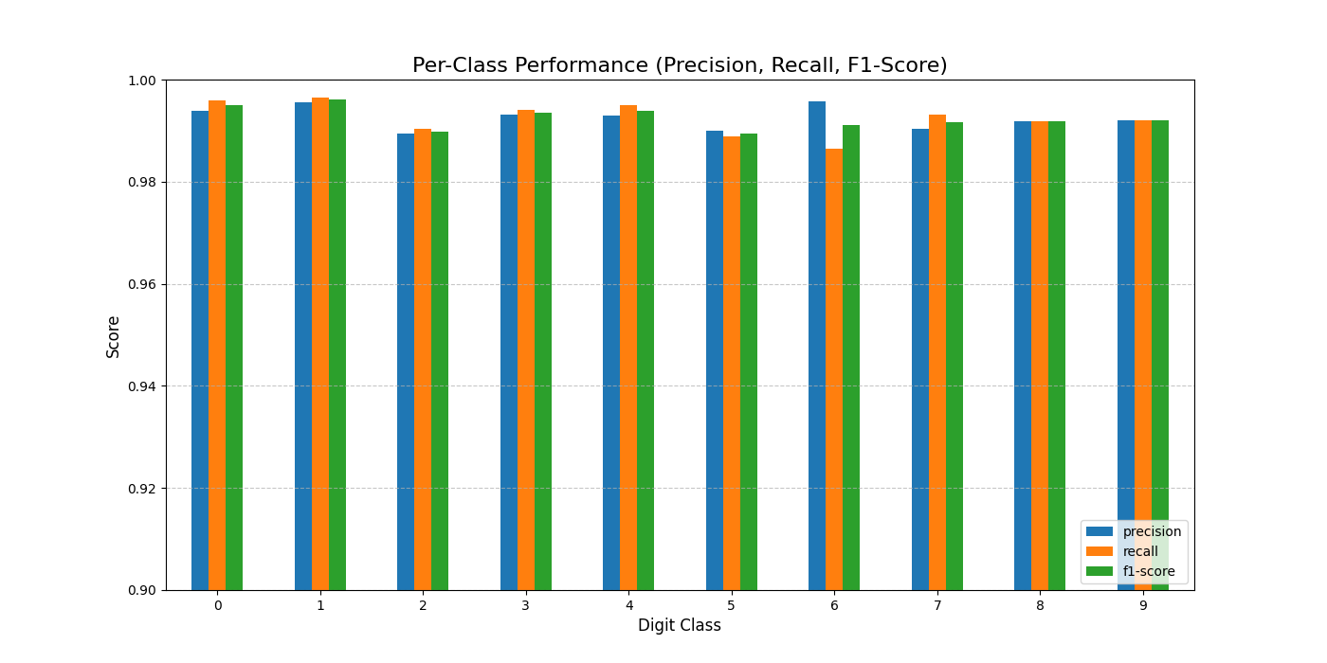
Result Interpretation
ONLY SVM CNN + SVM

Slide 13
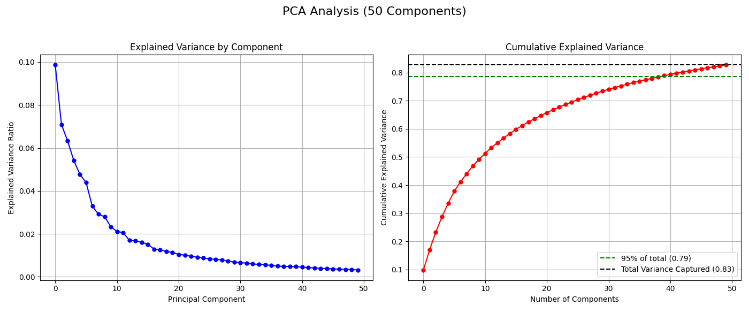
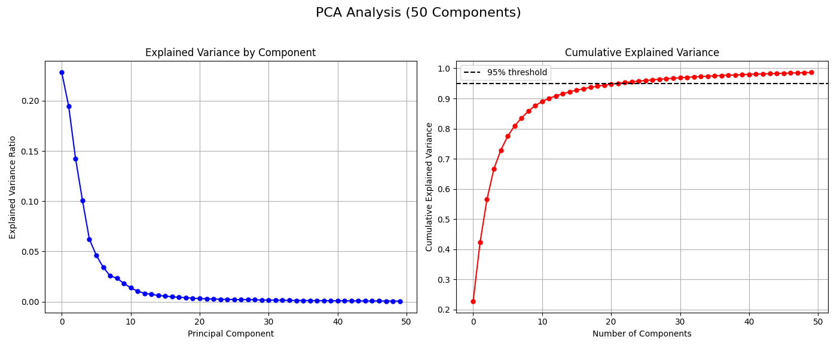
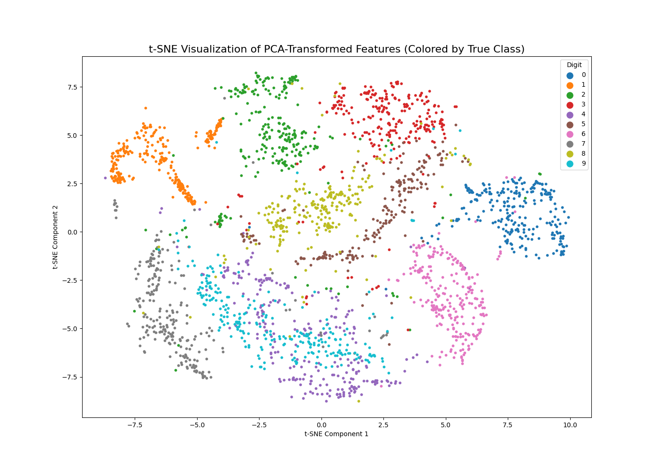
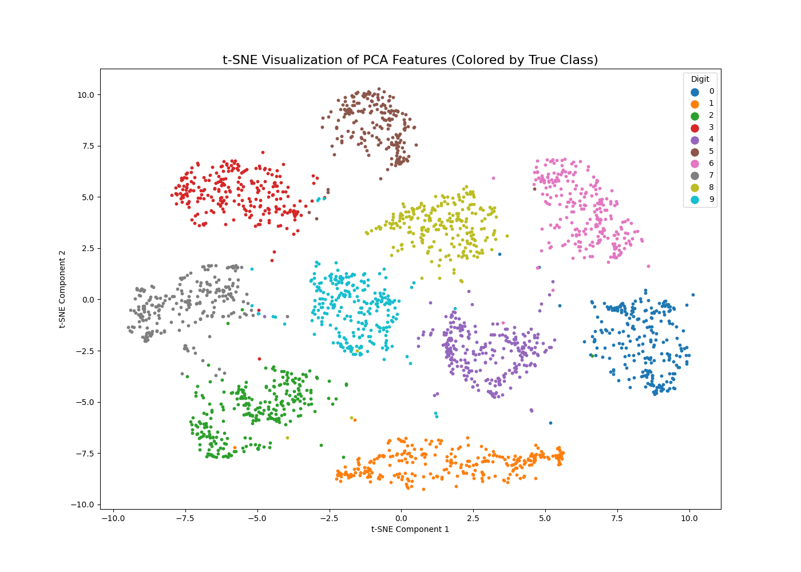
Result Interpretation
ONLY SVM CNN + SVM

Slide 14
Future Enhancement
While we have achieved high accuracy on MNIST, the original project goals included real-world robustness.
Enhance Real-World Generalization: Train and test the CNN+SVM model on more complex, noisy, and scanned document datasets (beyond MNIST).
Handle Connected Digits: Evolve the architecture from single-digit recognition to a segmentation-free model (e.g., using a CNN-RNN structure) to recognize overlapping or connected digit strings.
Expand to Multilingual Characters: Adapt the CNN feature extractor to recognize handwritten characters from at least one additional language, as planned in the initial objectives.
Real-Time Deployment: Package the trained CNN extractor, PCA transformer, and SVM classifier into a deployable API or a simple web application for real-world use.

Slide 15
Conclusion
Our journey began with a simple yet powerful idea — leveraging classical machine learning for handwritten digit recognition.
Review 1: Introduced Support Vector Machines (SVM) as a robust baseline for digit classification.
Review 2: Optimized performance using a PCA + SVM pipeline, achieving 97.86% accuracy through dimensionality reduction.
Review 3: Elevated the model by integrating a CNN feature extractor, forming a hybrid CNN–PCA–SVM architecture that reached 99.25% accuracy.
Key Learning:
The project clearly demonstrates that the quality of extracted features dictates the ceiling of a model’s performance.
By enriching the input space with deep CNN-derived representations, we unlocked the full potential of the SVM classifier — achieving state-of-the-art accuracy through the synergy of deep learning and classical ML.

Slide 16
References
C. Cortes and V. Vapnik, “Support-vector networks,” in Machine learning, vol. 20, no. 3, pp. 273–297, 1995.
L. Deng, “The MNIST database of handwritten digit images for machine learning research [best of the web],” in IEEE Signal Processing Magazine, vol. 29, no. 6, pp. 141–142, 2022.
M. Raheem and N. F. Abubacker, “HANDWRITTEN DIGIT RECOGNITION USING MACHINE LEARNING,” in Journal of Theoretical and Applied Information Technology, vol. 102, no. 5, pp. 2172-2180, Mar. 2024.
Y. Berrich and Z. Guennoun, “Handwritten Digit Recognition System based on CNN and SVM,” in Signal & Image Processing : An International Journal, vol. 13, no. 6, Dec. 2022.
R. Tang, X. Liu, and T. Hu, “An Improved Handwritten Recognition Method Using CNN-SVM Based on Successive Over-Relaxation Iteration,” in Proc. 6th International Conference on Data-driven Optimization and Machine Learning, 2024.

